Slide 1
Process Flow for Bigs and Littles

Slide 2


After 13-15 tests to experiment to sign up process, IUCG has noticed several instances of issues
Received Emails
Phone Number (Calls)
1st Group of individuals (4 entries) received around 3 follow-up emails each since submitting the forms to request for an interview
2nd Group of Individuals (8 entries) did not receive any form of emails as of yet
No follow up was sent even after errors were shown on website to individuals
Only 1 respondent from the entire set of individuals who filled the form received a phone call
Once picked up, there was:
No response from the caller’s end
Lack of direct confirmation that it was the BBBSEM agency calling

Slide 3
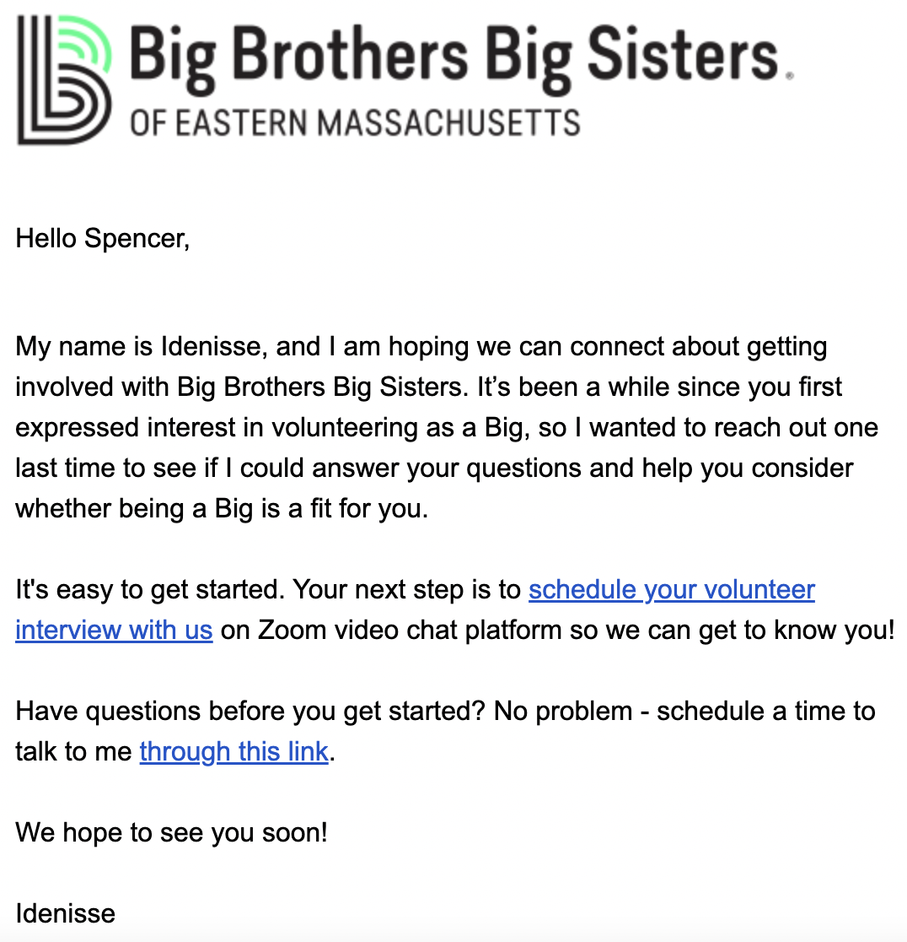
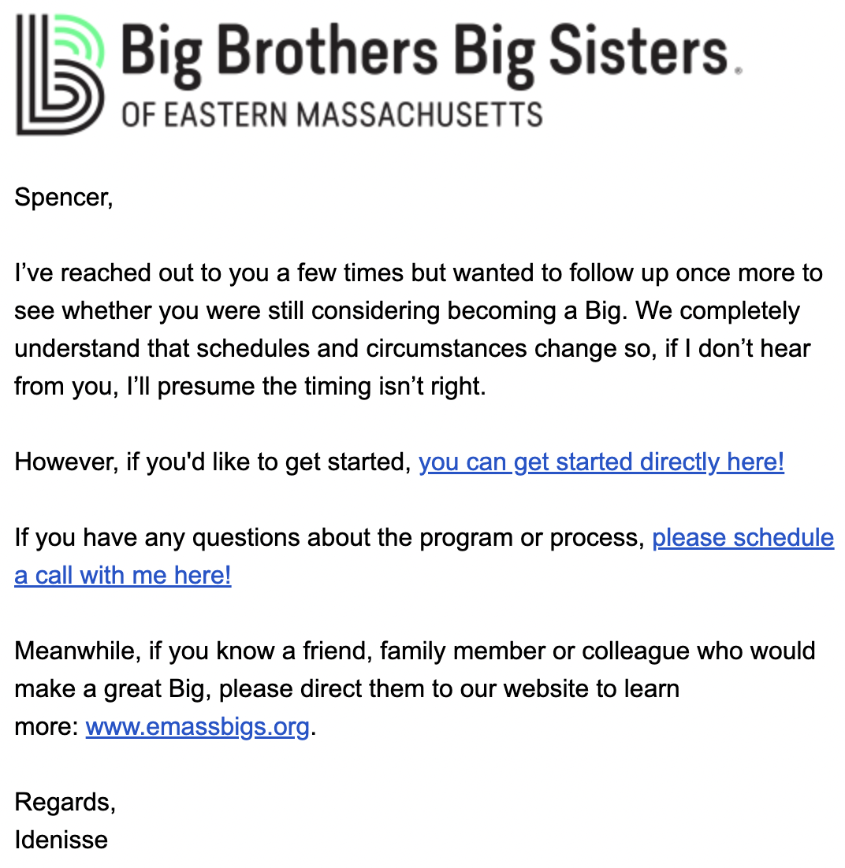
Here are 2 examples of emails received after a Form Completion by an individual (Spencer)
Email 1 (9.18) Email 2 (9.21)

Slide 4





Marketing Funnel (Meredith)
BBBSEM Engagement
45% Retention
75% Retention
News media features (Cambridge Day, Watertown News)
Social media (LinkedIn, Instagram)
Blog (case stories, initiatives)
16 days - 2 months
1 - 5 months
Online Inquiry
Interview
Match
Programming

Slide 5





Recruiting Funnel
45%
75%
16 days – 2 months
1-5 months
Recruiting Event with targeted organization
Interested Attendees Submit Inquiry
Applicants Complete Virtual Interview
Bigs are matched from little preferences

Slide 6






Marketing for Littles
BBBSEM Outreach
Permission slips signed by families
Start of Match
Teachers distribute material
Interview
Programming

